Slide 1
Lecture 6
CdM-8 CPU overview
Computing platforms, semester 2
Novosibirsk State University
University of Hertfordshire
D. Irtegov, A.Shafarenko
2019

Slide 2
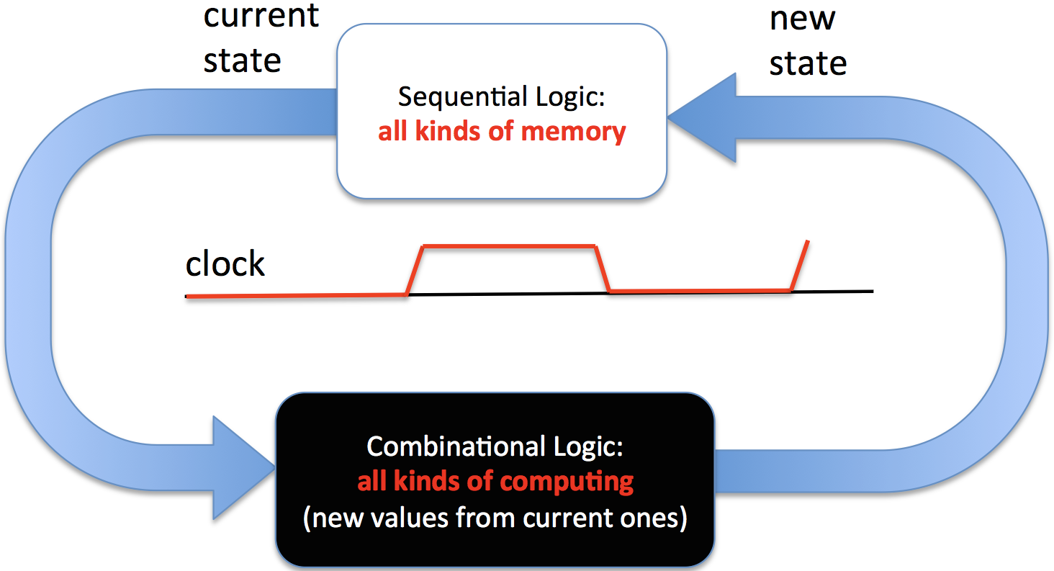
Generic sequential logical device

Slide 3
Clock
Typical digital device is driven by clock generator
Many devices (even as complex as CPU) have single clock synchronizing all events on the chip
  We will probably discuss some issues with devices that have several clocks
Events are driven by raising or falling edge of the clock
In CdM-8 and in most examples in the tome.pdf,
  Register values are latched by falling edge of the clock,
  Computations are enabled by raising edge
In practice, other arrangements are used, but this is beyond scope of our course (you will study it in advanced hardware design courses)

Slide 4
About gating the clock
Tome.pdf has whole page devoted to not gating the clock signal
It might be tempting to disable clock signal for the units you do not need in this cycle
In real circuits this trick is used to reduce power consumption
It requires skills and knowledge you do not have
  You need to properly shutdown unit before turning the clock off
  You need to properly reset the unit before turning the clock on
You do not need to conserve power in Logisim
Do NOT gate the clock, use Enable signals and output mux

Slide 5
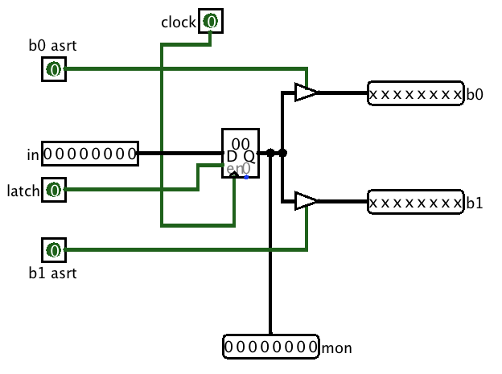
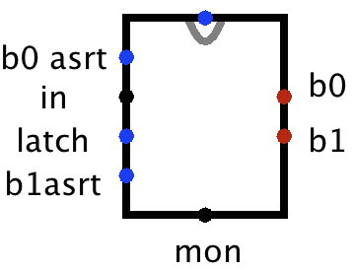
CdM-8 register
Register pinout

Slide 6
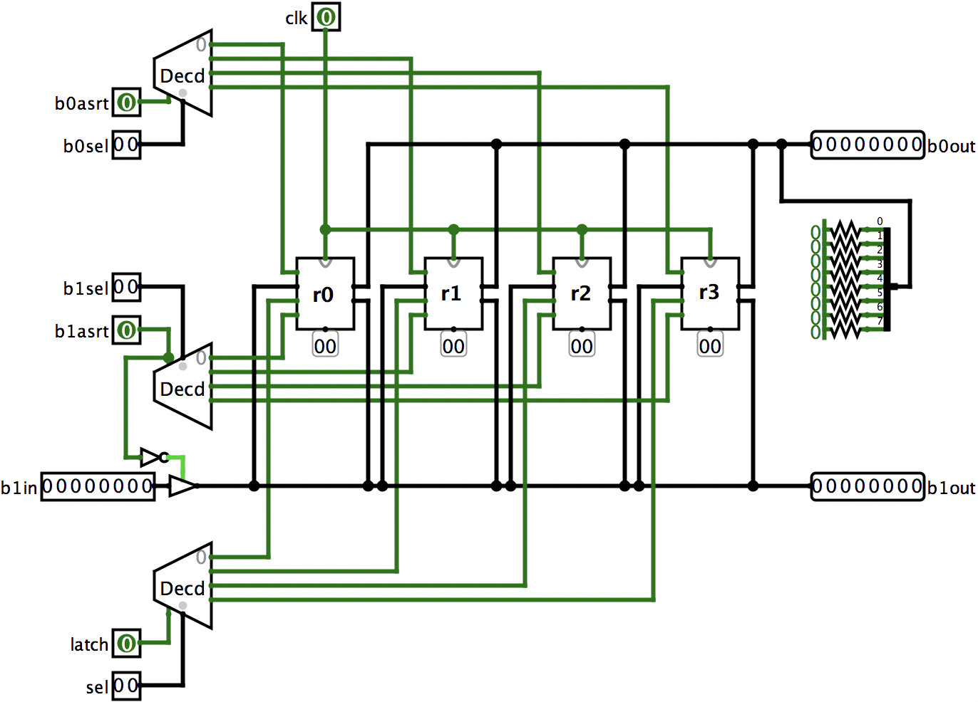
Register file

Slide 7
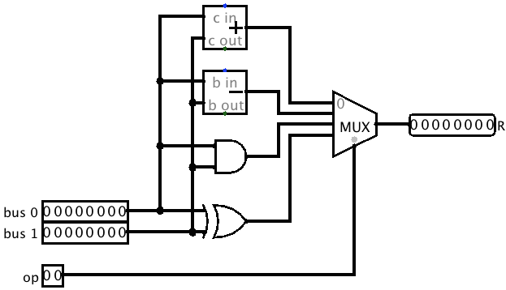
Arithmetical-Logical Unit (simplified)

Slide 8
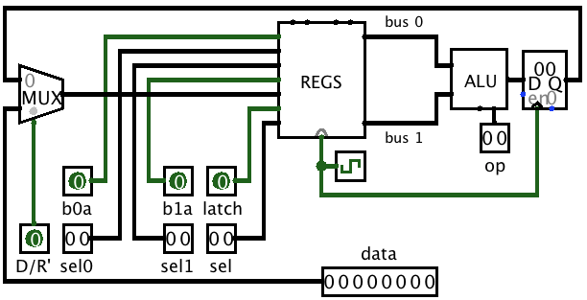
Datapath (simplified)

Slide 9
Execution of simple program
ldi r3,7
ldi r2,4
sub r3,r2

Slide 10
Register transfer language
r[2]->bus1, bus1->r[3]
immediate, 7, bus1-> r[3] # ldi r3,7
immediate, 4, bus1-> r[2] # ldi r2,4
r[3]->bus0, r[2]->bus1, # sub r3,r2 1st cycle
subtract result, bus1->r2 # 2nd cycle

Slide 11
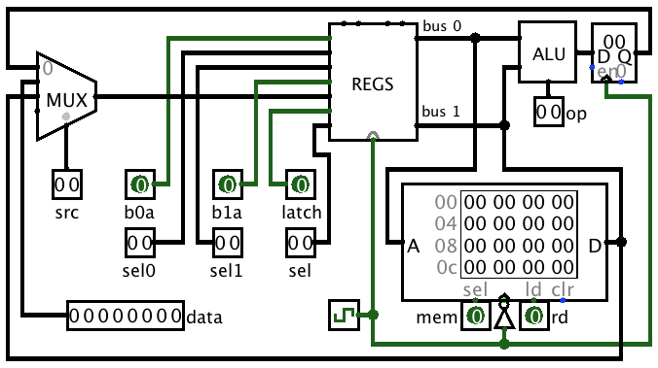
Data path with memory

Slide 12
“Real” program in RTL
immediate, 0xa3, bus1-> r[0] # ldi r0,0xa3
memory, r[0]->bus0, bus1-> r[1], load # ld r0,r1
immediate, 1, bus1->r[2] # ldi r2,1
r[1]->bus0, r[2]->bus1, add # add r1,r2 1st cycle
result, bus1->r[2] # 2nd cycle
r[0]->bus0, r[2]->bus1, store # st r0,r2

Slide 13
Command Sequencer
Instruction execution cycle:
fetch, phase1, phase2, . . . phasen, fetch, phase1,. . .
Instruction machine can reset the sequencer cycle and start fetch of the next instruction
  This allows instructions with different number of phases
Core of the sequencer is three-bit register incremented at every falling edge of the clock
This allows 8 phases in the single instruction
Currently most complex CdM-8 instruction (ioi) requires 6 phases

Slide 14
Instruction machine (CPU control unit)
DP
triggers
Sequencer
phase1
Secondary Decoder
…
latch
phase2
fetch
op-code
fetch
logic
from
ALU
Primary Decoder
taken
branch logic
PS
PC=PC+1
read
latch
CVZN
instr
cond
PC
addr
Memory
instr
IR
DP
selectors
shared with DP

Slide 15
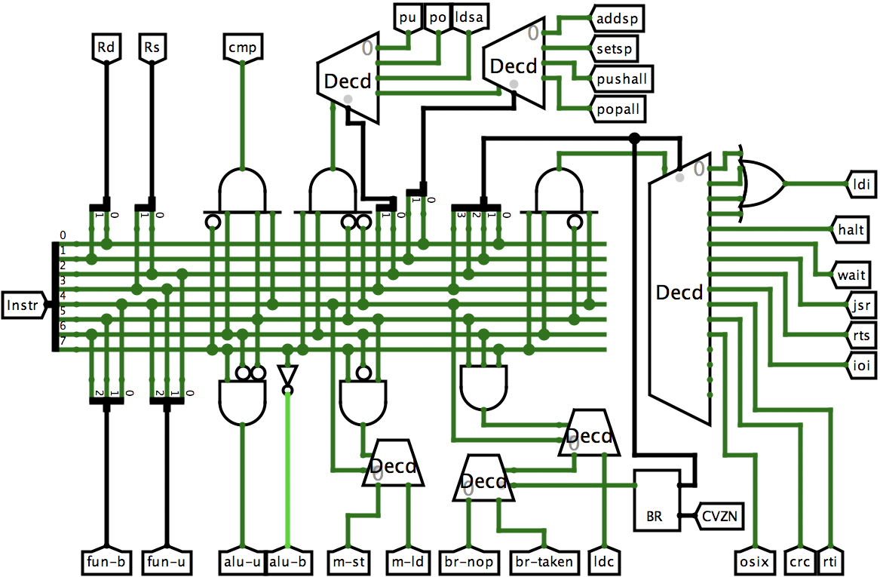
Primary decoder

Slide 16
Actual datapath of CdM-8
RR – result register (ALU output)
RX used by jsr logic for optimization
PS and SP have their own incrementors
Register file
bus0
PS
(CVZN)
CVZN
to branch
logic
Instr
r3
RR
+1
±1
r0
r1
r2
RX
PC
SP
IR
ALU
bus1
memory

Slide 17
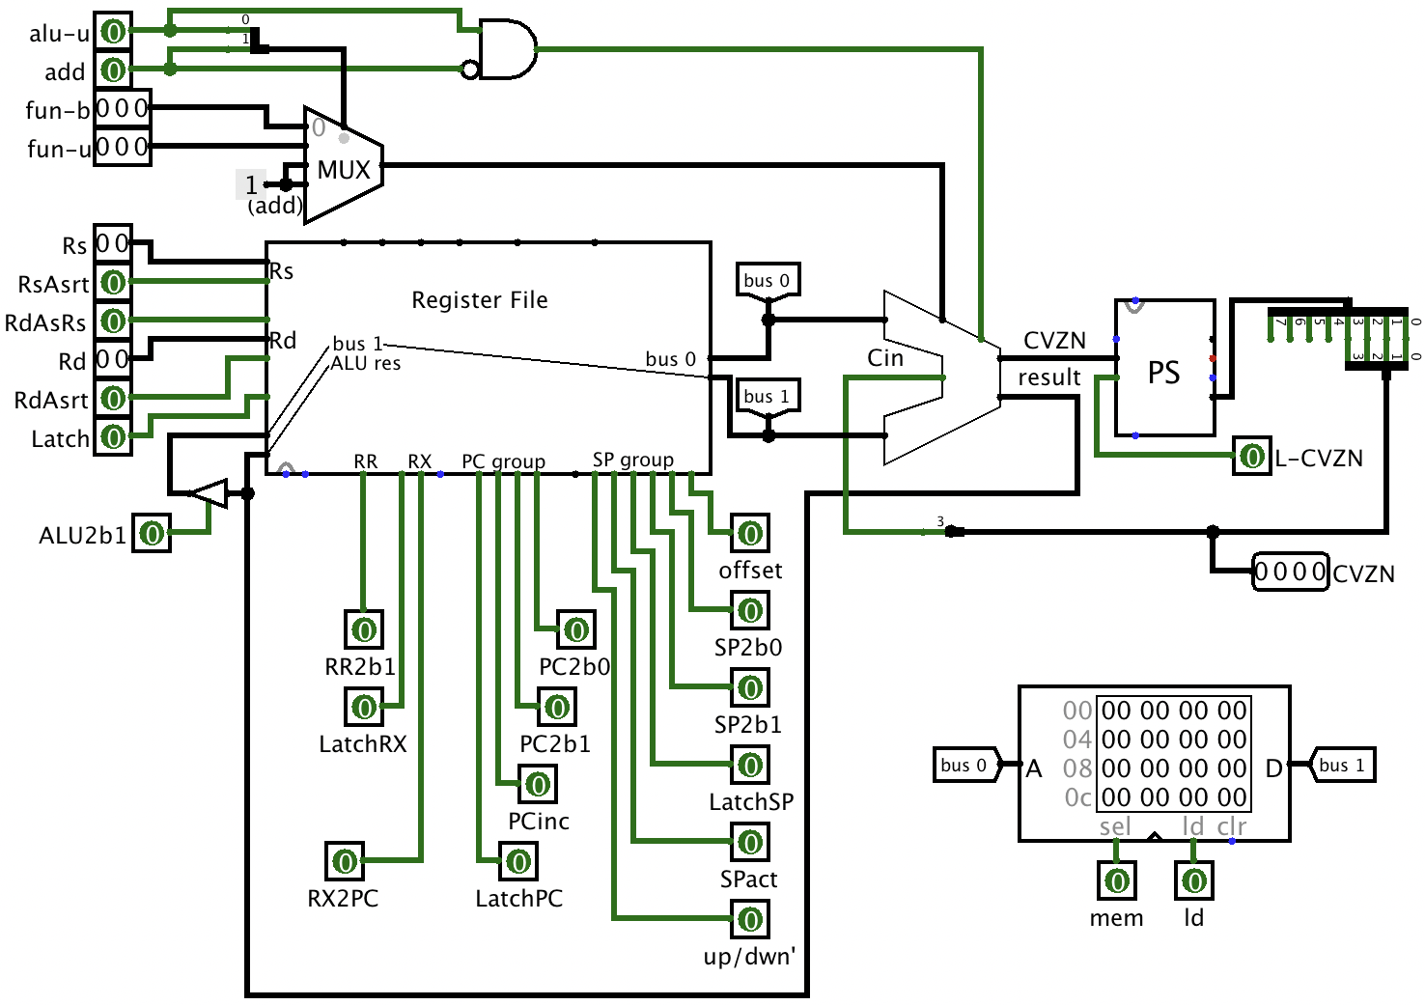
Full implementation of datapath

Slide 18
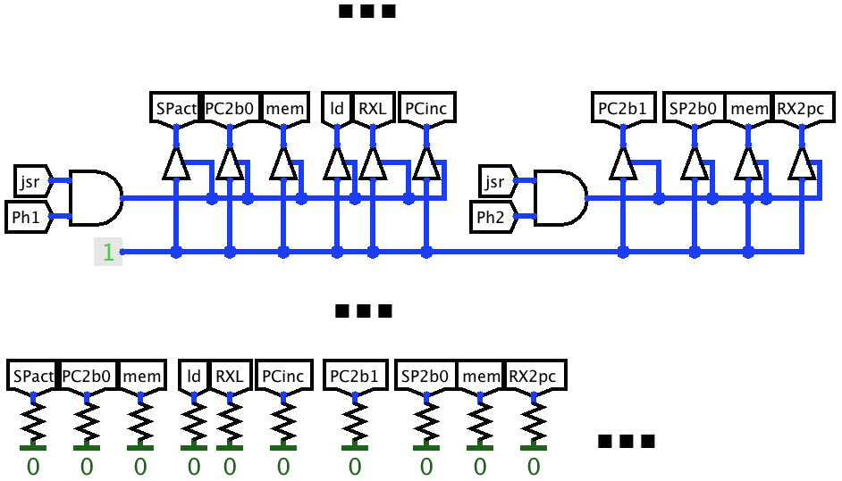
Secondary decoder
Set of disjoint modules specific for every multiphase instruction or instruction group
Example:
jsr decoder
Two phases
All outputs are
pulled to zero by
pulldown resistors
(Wire-OR)

Slide 19
JSR secondary decoder explanation (Phase1)
Decrement SP (SPact signal)
Load operand from memory to RX
  Assert PC on bus 0 (PC2b0 signal)
  Load from memory (mem and ld signals), address on bus 0 (PC value)
  Read to RX (RXL signal)
Increment PC (PCinc signal)
  This is needed so the saved PC will point to the next instruction
  (not to jsr operand)

Slide 20
JSR secondary decoder explanation (Phase2)
Store PC to top of the stack
  Assert PC on bus 1 (PC2b1 signal)
  Assert SP on bus 0 (SP2b0 signal)
  Write to memory (mem signal, no ld signal),
  address on b0 (SP), value on b1 (PC)
  Transfer RX to PC (RX2pc signal)

Slide 21
Secondary decoders (main part)

Slide 22
ROM/LGA as instruction decoders
Both primary and secondary decoders are purely combinatory circuits
They take bit-string as input and produce another bit-string as output
Primary decoder takes 8-bit ISA opcode and produces 15 control signals (most of them are zeros in most cases)
As such, they can be replaced by Logical Gate Array (LGA) or ROM
Because most of outputs are zero, LGA might be cheaper
This would be less funny to watch in simulator, but more similar to how industrially used CPU are built

